Slide 1

Chapter 7 Wireless and
Mobile Networks
Computer Networking: A Top-Down Approach 8th edition Jim Kurose, Keith Ross Pearson, 2020
Acknowledgement: Based on the textbook’s website: https://gaia.cs.umass.edu/kurose_ross/index.php
Notes:
Version History
8.0 (May 2020)
All slides reformatted for 16:9 aspect ratio
All slides updated to 8th edition material
Use of Calibri font, rather that Gill Sans MT
Add LOTS more animation throughout
lighter header font
4G/5G material completely updated; older 2/2.5/3G removed
8.2 (July 2023). Changes from 8.0:
minor updates and additional, including removing master/slave Bluetooth language
expansion, better graphics on wireless link characteristics
expanded, significant revisions of 4G/5G material (but not mobility)

Slide 2
Wireless and Mobile Networks: context
more wireless (mobile) phone subscribers than fixed (wired) phone subscribers (10-to-1 in 2019)!
more mobile-broadband-connected devices than fixed-broadband-connected devices devices (5-1 in 2019)!
4G/5G cellular networks now embracing Internet protocol stack, including SDN
two important (but different) challenges
wireless: communication over wireless link
mobility: handling the mobile user who changes point of attachment to network

Slide 3

Chapter 7 outline
Introduction
Wireless
Wireless Links and network characteristics
WiFi: 802.11 wireless LANs
Cellular networks: 4G and 5G
Mobility
Mobility management: principles
Mobility management: practice
4G/5G networks
Mobile IP
Mobility: impact on higher-layer protocols

Slide 4



















Elements of a wireless network
wired network
infrastructure

Slide 5





Elements of a wireless network
wireless hosts
laptop, smartphone, IoT
run applications
may be stationary (non-mobile) or mobile
wireless does not always mean mobility!
wired network
infrastructure

Slide 6

Elements of a wireless network
base station
typically connected to wired network
relay - responsible for sending packets between wired network and wireless host(s) in its “area”
e.g., cell towers, 802.11 access points
wired network
infrastructure

Slide 7
Elements of a wireless network
wireless link
typically used to connect mobile(s) to base station, also used as backbone link
multiple access protocol coordinates link access
various transmission rates and distances, frequency bands
wired network
infrastructure

Slide 8
Characteristics of selected wireless links
14 Gbps
802.11ax
10 Gbps
5G
3.5 Gbps
802.11ac
802.11 af,ah
600 Mbps
802.11n
4G LTE
54 Mbps
802.11g
11 Mbps
802.11b
2 Mbps
Bluetooth
Indoor
Outdoor
Midrange
outdoor
Long range
outdoor
10-30m
50-200m
200m-4Km
4Km-15Km

Slide 9
Elements of a wireless network
infrastructure mode
base station connects mobiles into wired network
handoff: mobile changes base station providing connection into wired network
wired network
infrastructure

Slide 10
Elements of a wireless network
ad hoc mode
no base stations
nodes can only transmit to other nodes within link coverage
nodes organize themselves into a network: route among themselves

Slide 11
Wireless network taxonomy
single hop
multiple hops
host connects to base station (WiFi, cellular) which connects to larger Internet
host may have to relay through several wireless nodes to connect to larger
Internet: mesh net
infrastructure
(e.g., APs)
no base station, no connection to larger Internet (Bluetooth, ad hoc nets)
no base station, no connection to larger Internet. May have to relay to reach other a given wireless node MANET, VANET
no
infrastructure

Slide 12
Chapter 7 outline
Introduction
Wireless
Wireless links and network characteristics
WiFi: 802.11 wireless LANs
Cellular networks: 4G and 5G
Mobility
Mobility management: principles
Mobility management: practice
4G/5G networks
Mobile IP
Mobility: impact on higher-layer protocols

Slide 13
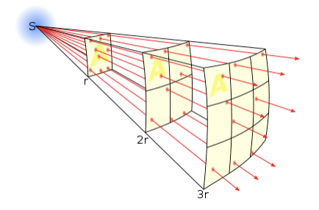
Wireless link characteristics: fading (attenuation)
Wireless radio signal attenuates (loses power) as it propagates (free space “path loss”)
Free space path loss ~ (fd)²
f: frequency
d: distance
higher frequency or longer distance
larger free space
path loss
Notes:
Wikipedia figure

Slide 14




Wireless link characteristics: multipath
multipath propagation: radio signal reflects off objects ground, built environment, arriving at destination at slightly different times
reflected path
line of sight
(LOS) path
reflected path

Slide 15
Wireless link characteristics: multipath
multipath propagation: radio signal reflects off objects ground, built environment, arriving at destination at slightly different times
Coherence time:
amount of time bit is present in channel to be received
influences maximum possible transmission rate, since coherence times can not overlap
inversely proportional to
frequency
receiver velocity
transmitted
pulses
time
received
LOS pulse
received
multipath
pulses
received
multipath
pulses
received
LOS pulse
received
pulse
time
T_{c}: coherence time

Slide 16
Wireless link characteristics: noise
interference from other sources on wireless network frequencies: motors, appliances
SNR: signal-to-noise ratio
larger SNR – easier to extract signal from noise (a “good thing”)
SNR versus BER tradeoff
given physical layer: increase power -> increase SNR->decrease BER
SNR may change with mobility: dynamically adapt physical layer (modulation technique, rate)
10⁻¹
10⁻²
10⁻³
BER
10⁻⁴
10⁻⁵
10⁻⁶
10⁻⁷
10
20
30
40
SNR(dB)
QAM256 (8 Mbps)
QAM16 (4 Mbps)
BPSK (1 Mbps)

Slide 17

Wireless link characteristics: hidden terminals
Hidden terminal problem
B, A hear each other
B, C hear each other
A, C can not hear each other means A, C unaware of their interference at B
Attenuation also causes “hidden terminals”
B, A hear each other
B, C hear each other
A, C can not hear each other interfering at B
C
A
B
C
B
A
C’s signal
strength
A’s signal
strength
space

Slide 18
Chapter 7 outline
Introduction
Wireless
Wireless links and network characteristics
CDMA: code division multiple access
WiFi: 802.11 wireless LANs
Bluetooth

Slide 19
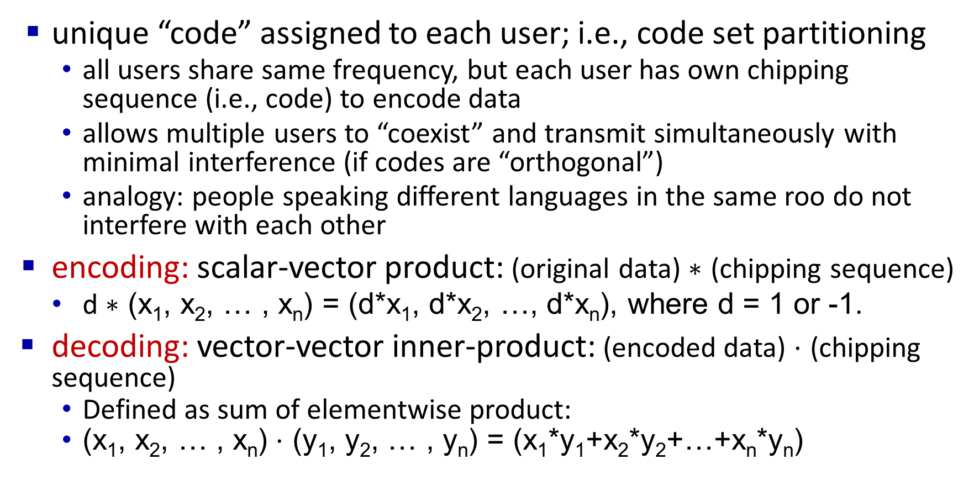
Code Division Multiple Access (CDMA)
unique “code” assigned to each user; i.e., code set partitioning
all users share same frequency, but each user has own chipping sequence (i.e., code) to encode data
allows multiple users to “coexist” and transmit simultaneously with minimal interference (if codes are “orthogonal”)
analogy: people speaking different languages in the same roo do not interfere with each other
encoding: scalar-vector product: (original data) $∗$ (chipping sequence)
d $∗$ (x₁, x₂, … , x_{n}) = (d*x₁, d*x₂, …, d*x_{n}), where d = 1 or -1.
decoding: vector-vector inner-product: (encoded data) $⋅$ (chipping sequence)
Defined as sum of elementwise product:
(x₁, x₂, … , x_{n}) $⋅$ (y₁, y₂, … , y_{n}) = (x₁*y₁+x₂*y₂+…+x_{n}*y_{n})

Slide 20
Direct-Sequence Spread Spectrum CDMA
1
1
1
1
-1
-1
-1
Chipping sequence (Code): (1,1,1,-1,1,-1,-1,-1)
The 8-bit sequence 1*(1,1,1,-1,1,-1,-1,-1) encodes data bit 1 (corresponding to application bit 1).
The 8-bit sequence (-1)*(1,1,1,-1,1,-1,-1,-1) = (-1,-1,-1,1,-1,1,1,1) encodes data bit -1 (corresponding to application bit 0).
Spreading factor = Code length/data bit = 8
10-100 commercial (Min 10 by FCC), 10,000 for military
Notes:
Signal bandwidth > 10 × data bandwidth
Code sequence synchronization
Z_{i,m}= d_{i}.c_{m}
-1*(1,1,1,-1,1,-1,-1,-1) = (-1,-1,-1,1,-1,1,1,1)
1*(1,1,1,-1,1,-1,-1,-1) = (1,1,1,-1,1,-1,-1,-1)
Correlation between codes ⇒ Interference ⇒ Orthogonal

Slide 21
CDMA encode/decode
channel output Z_{i,m}
Z_{i,m}= d_{i}.c_{m}
Encoded data in slot 1:
-1*(1,1,1,-1,1,-1,-1,-1)
= (-1,-1,-1,1,-1,1,1,1)
data
bits
d₀ = 1
1
1
1
1
1
d₁ = -1
1
1
1
-
-
-
-
1
-
-
-
1
-
1
1
1
1
1
sender
1
1
slot 1
channel
output
slot 0
channel
output
1
1
1
1
1
code
1
1
-
-
-
1
-
1
1
1
-
-
-
1
-
1
1
1
slot 1
slot 0
M
d_{i} = Σ Z_{i,m}.c_{m}
m=1
receiver
M
received
input
1
1
1
1
1
1
1
1
d₀ = 1
-
-
-
-
1
-
-
-
1
-
1
1
1
1
1
1
d₁ = -1
1
slot 1
channel
output
slot 0
channel
output
1
1
1
1
1
code
1
1
-
-
-
1
-
1
1
1
-
-
-
1
-
1
1
1
slot 1
slot 0
Decoded data in slot 1:
= (1/8)*(-1,-1,-1,1,-1,1,1,1) ⋅ (1,1,1,-1,1,-1,-1,-1)
= -1

Slide 22
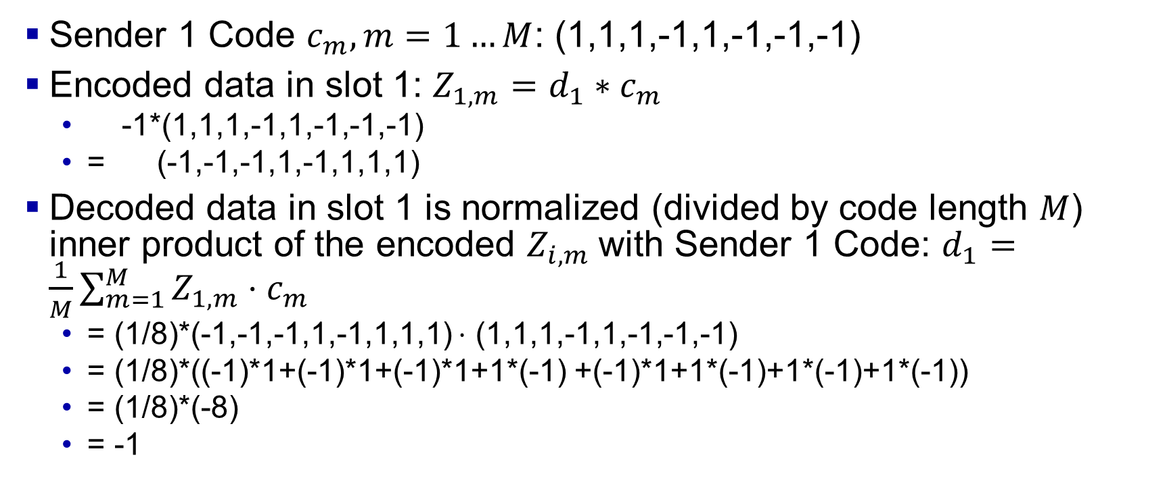
CDMA encode/decode
Sender 1 Code $c_{m}, m=1…M$: (1,1,1,-1,1,-1,-1,-1)
Encoded data in slot 1: $Z_{1,m}=d_{1}∗c_{m}$
-1*(1,1,1,-1,1,-1,-1,-1)
= (-1,-1,-1,1,-1,1,1,1)
Decoded data in slot 1 is normalized (divided by code length $M$) inner product of the encoded $Z_{i,m}$with Sender 1 Code: $d_{1}=\frac{1}{M}\sum_{m=1}^{M}{Z_{1,m}}⋅c_{m}$
= (1/8)*(-1,-1,-1,1,-1,1,1,1) $⋅$ (1,1,1,-1,1,-1,-1,-1)
= (1/8)*((-1)*1+(-1)*1+(-1)*1+1*(-1) +(-1)*1+1*(-1)+1*(-1)+1*(-1))
= (1/8)*(-8)
= -1

Slide 23
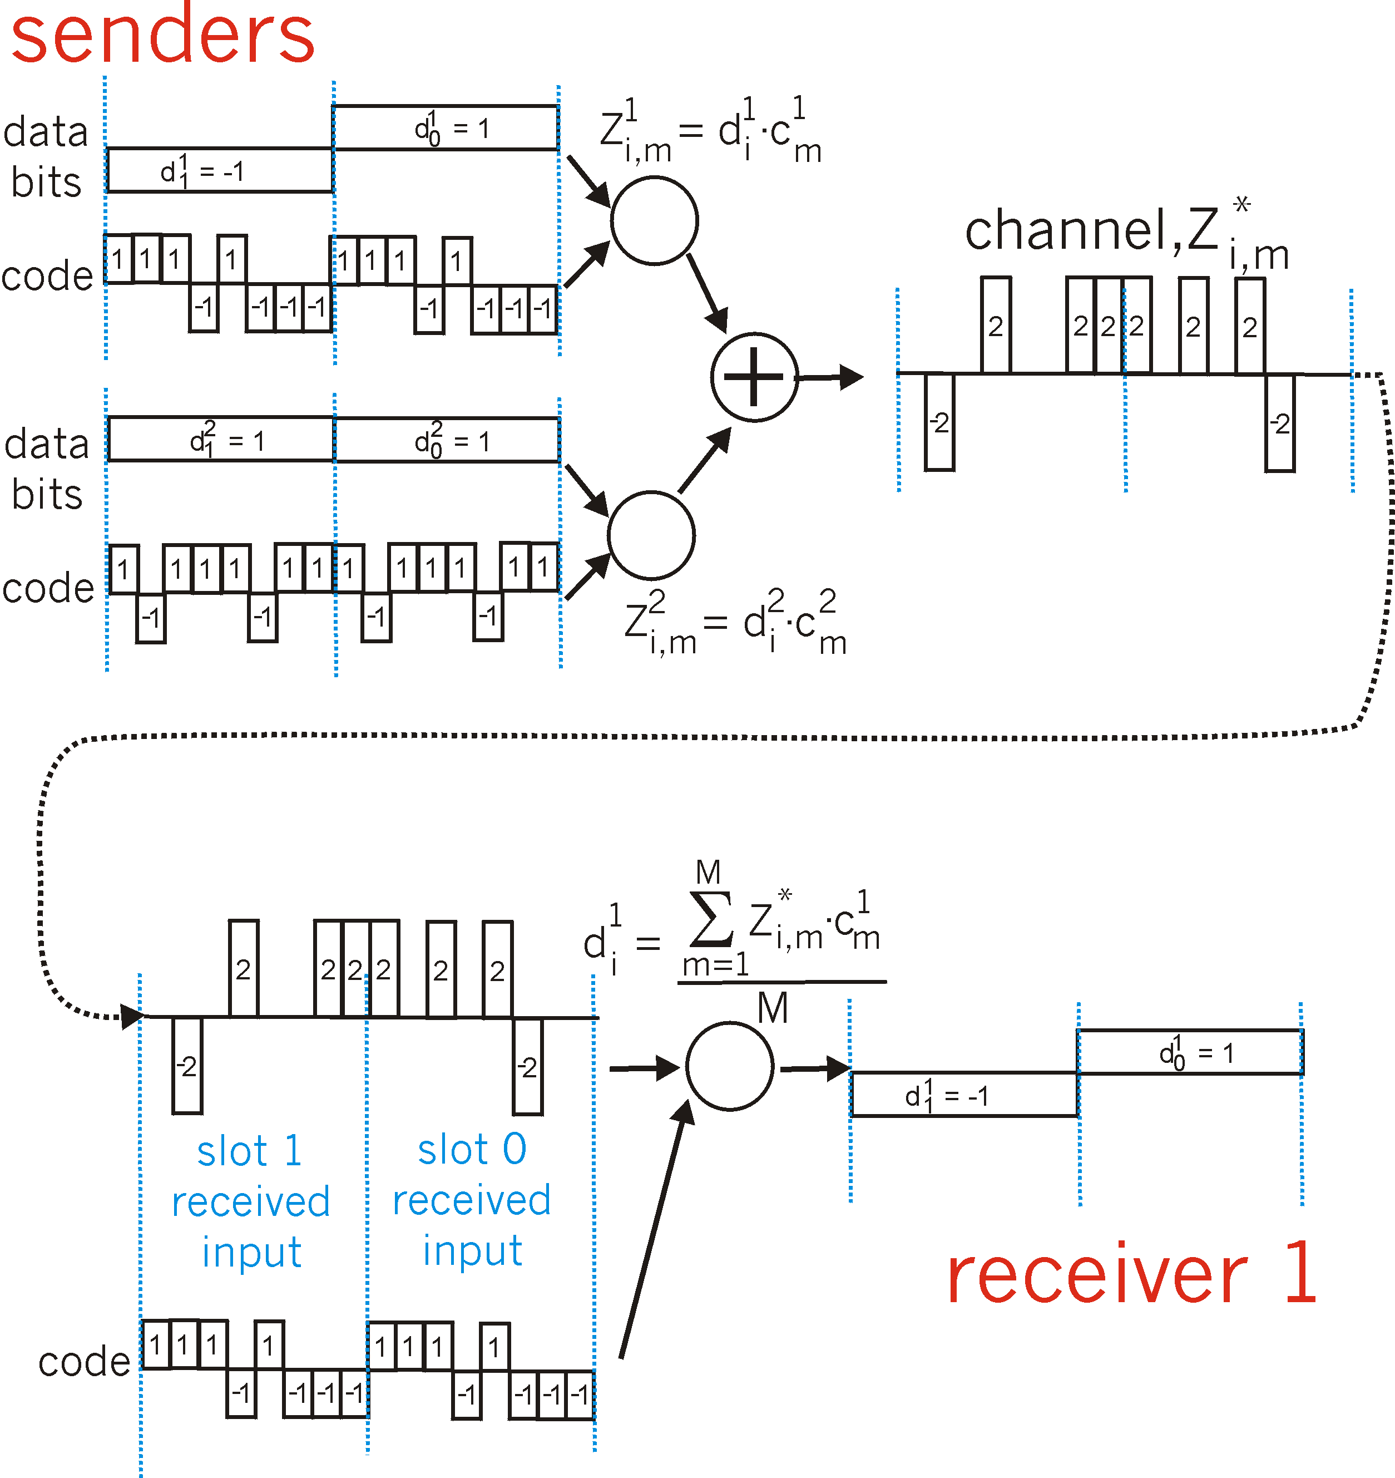
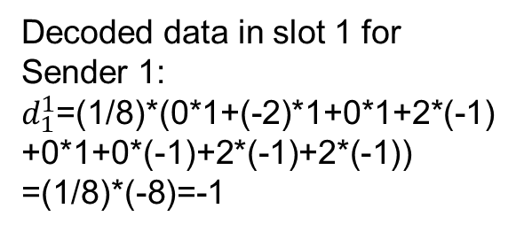
CDMA: two-sender interference
channel sums together transmissions by sender 1 and 2
Sender 1
Encoded data in slot 1:
-1*(1,1,1,-1,1,-1,-1,-1)
+ 1*(1,-1,1,1,1,-1,1,1)
= (0,-2,0,2,0,0,2,2)
Sender 2
using same code as sender 1, receiver recovers sender 1’s original data from summed channel data!
M=8 (# bits)
Decoded data in slot 1 for Sender 1:
$d_{1}^{1}$=(1/8)*(0*1+(-2)*1+0*1+2*(-1)
+0*1+0*(-1)+2*(-1)+2*(-1))
=(1/8)*(-8)=-1
provided the codes for different
senders are orthogonal

Slide 24
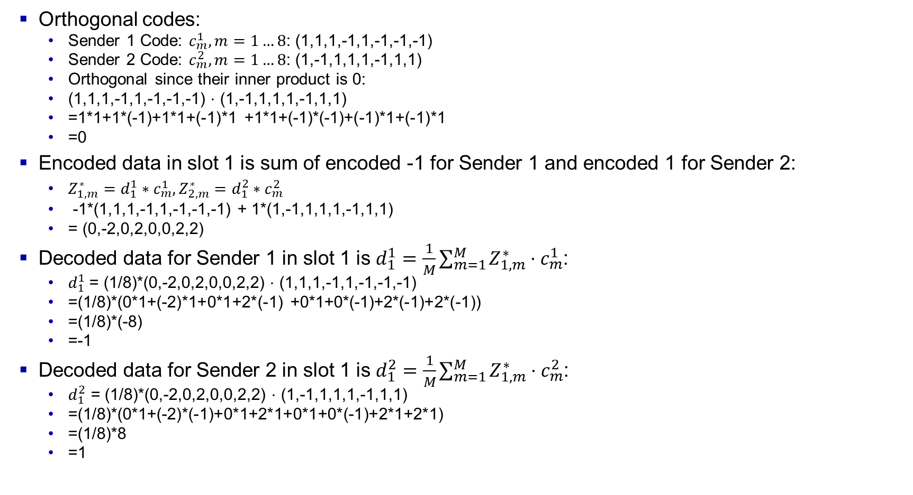
CDMA: two-sender interference
Orthogonal codes:
Sender 1 Code: $c_{m}^{1},m=1…8$: (1,1,1,-1,1,-1,-1,-1)
Sender 2 Code: $c_{m}^{2},m=1…8\text{:}$ (1,-1,1,1,1,-1,1,1)
Orthogonal since their inner product is 0:
(1,1,1,-1,1,-1,-1,-1) $⋅$ (1,-1,1,1,1,-1,1,1)
=1*1+1*(-1)+1*1+(-1)*1 +1*1+(-1)*(-1)+(-1)*1+(-1)*1
=0
Encoded data in slot 1 is sum of encoded -1 for Sender 1 and encoded 1 for Sender 2:
$Z_{1,m}^{∗}=d_{1}^{1}∗c_{m}^{1},Z_{2,m}^{∗}=d_{1}^{2}∗c_{m}^{2}$
-1*(1,1,1,-1,1,-1,-1,-1) + 1*(1,-1,1,1,1,-1,1,1)
= (0,-2,0,2,0,0,2,2)
Decoded data for Sender 1 in slot 1 is $d_{1}^{1}=\frac{1}{M}\sum_{m=1}^{M}{Z_{1,m}^{∗}}⋅c_{m}^{1}$:
$d_{1}^{1}$= (1/8)*(0,-2,0,2,0,0,2,2) $⋅$ (1,1,1,-1,1,-1,-1,-1)
=(1/8)*(0*1+(-2)*1+0*1+2*(-1) +0*1+0*(-1)+2*(-1)+2*(-1))
=(1/8)*(-8)
=-1
Decoded data for Sender 2 in slot 1 is $d_{1}^{2}=\frac{1}{M}\sum_{m=1}^{M}{Z_{1,m}^{∗}}⋅c_{m}^{2}$:
$d_{1}^{2}$ = (1/8)*(0,-2,0,2,0,0,2,2) $⋅$ (1,-1,1,1,1,-1,1,1)
=(1/8)*(0*1+(-2)*(-1)+0*1+2*1+0*1+0*(-1)+2*1+2*1)
=(1/8)*8
=1

Slide 25
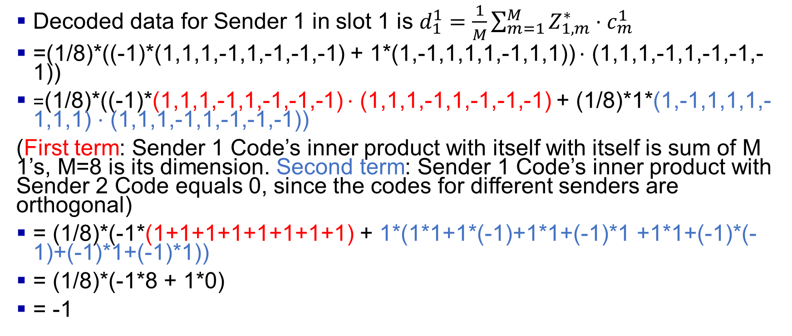
CDMA: two-sender interference: Explanations
Decoded data for Sender 1 in slot 1 is $d_{1}^{1}=\frac{1}{M}\sum_{m=1}^{M}{Z_{1,m}^{∗}}⋅c_{m}^{1}$
=(1/8)*((-1)*(1,1,1,-1,1,-1,-1,-1) + 1*(1,-1,1,1,1,-1,1,1)) $⋅$ (1,1,1,-1,1,-1,-1,-1))
=(1/8)*((-1)*(1,1,1,-1,1,-1,-1,-1) $⋅$ (1,1,1,-1,1,-1,-1,-1) + (1/8)*1*(1,-1,1,1,1,-1,1,1) $⋅$ (1,1,1,-1,1,-1,-1,-1))
(First term: Sender 1 Code’s inner product with itself with itself is sum of M 1’s, M=8 is its dimension. Second term: Sender 1 Code’s inner product with Sender 2 Code equals 0, since the codes for different senders are orthogonal)
= (1/8)*(-1*(1+1+1+1+1+1+1+1) + 1*(1*1+1*(-1)+1*1+(-1)*1 +1*1+(-1)*(-1)+(-1)*1+(-1)*1))
= (1/8)*(-1*8 + 1*0)
= -1

Slide 26
Quiz 1
Q1: Consider the codes for two senders: Sender 1 Code: (1,-1,-1,-1,1,-1,-1,-1), Sender 2 Code: (1,-1,1,-1,1,-1,1,-1). Are they orthogonal?
Q2: Consider the codes for two senders: Sender 1 Code: (1,-1,1,-1,1,-1,-1,-1), Sender 2 Code: (1,1,1,1,1,-1,1,-1). Are they orthogonal?
Q3: With the codes in Q2, suppose Sender 1 sends data bit 1 and Sender 2 sends data bit -1 simultaneously, compute the encoded data.
Q4: Compute the decoded data bit for Sender 1 and decoded data bit Sender 2.

Slide 27
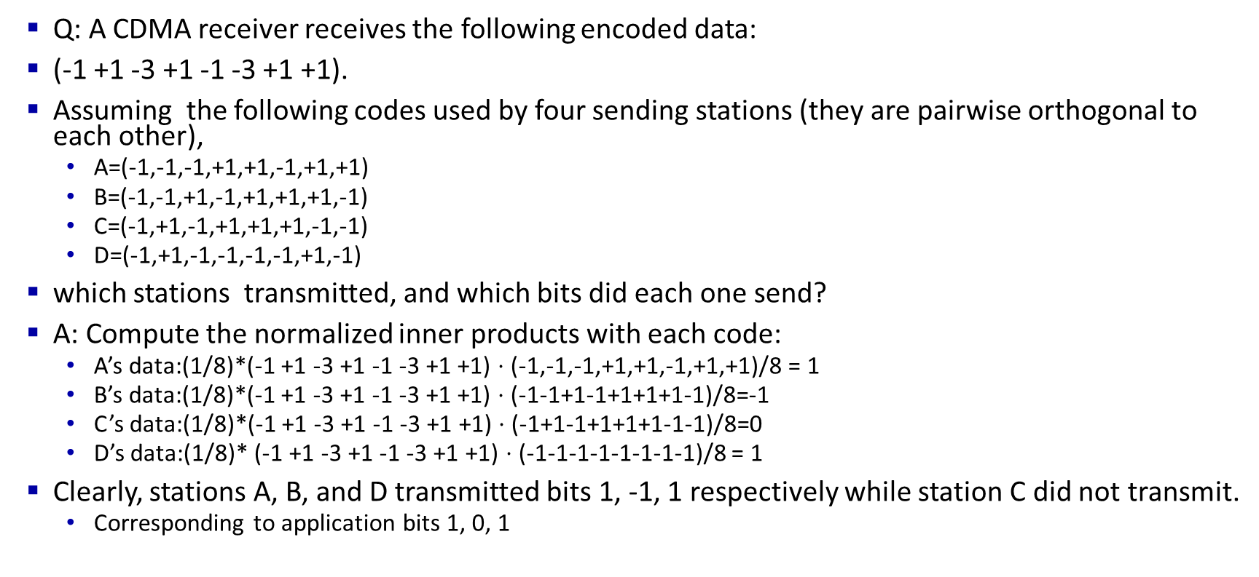
Quiz 2
Q: A CDMA receiver receives the following encoded data:
(-1 +1 -3 +1 -1 -3 +1 +1).
Assuming the following codes used by four sending stations (they are pairwise orthogonal to each other),
A=(-1,-1,-1,+1,+1,-1,+1,+1)
B=(-1,-1,+1,-1,+1,+1,+1,-1)
C=(-1,+1,-1,+1,+1,+1,-1,-1)
D=(-1,+1,-1,-1,-1,-1,+1,-1)
which stations transmitted, and which bits did each one send?
A: Compute the normalized inner products with each code:
A’s data:(1/8)*(-1 +1 -3 +1 -1 -3 +1 +1) $⋅$ (-1,-1,-1,+1,+1,-1,+1,+1)/8 = 1
B’s data:(1/8)*(-1 +1 -3 +1 -1 -3 +1 +1) $⋅$ (-1-1+1-1+1+1+1-1)/8=-1
C’s data:(1/8)*(-1 +1 -3 +1 -1 -3 +1 +1) $⋅$ (-1+1-1+1+1+1-1-1)/8=0
D’s data:(1/8)* (-1 +1 -3 +1 -1 -3 +1 +1) $⋅$ (-1-1-1-1-1-1-1-1)/8 = 1
Clearly, stations A, B, and D transmitted bits 1, -1, 1 respectively while station C did not transmit.
Corresponding to application bits 1, 0, 1

Slide 28
Chapter 7 outline
Introduction
Wireless
Wireless links and network characteristics
WiFi: 802.11 wireless LANs
Cellular networks: 4G and 5G
Mobility
Mobility management: principles
Mobility management: practice
4G/5G networks
Mobile IP
Mobility: impact on higher-layer protocols

Slide 29
IEEE 802.11 Wireless LAN
IEEE 802.11 standard | Year | Max data rate | Range | Frequency
802.11b | 1999 | 11 Mbps | 30 m | 2.4 Ghz
802.11g | 2003 | 54 Mbps | 30m | 2.4 Ghz
802.11n (WiFi 4) | 2009 | 600 | 70m | 2.4, 5 Ghz
802.11ac (WiFi 5) | 2013 | 3.47Gpbs | 70m | 5 Ghz
802.11ax (WiFi 6) | 2020 (exp.) | 14 Gbps | 70m | 2.4, 5 Ghz
802.11af | 2014 | 35 – 560 Mbps | 1 Km | unused TV bands (54-790 MHz)
802.11ah | 2017 | 347Mbps | 1 Km | 900 Mhz
all use CSMA/CA for multiple access, and differ in the physical layer (frequency range)
For the same power and coding, higher frequency (longer wavelengths) will have lower data rate and longer distances.

Slide 30



Wireless Network Taxonomy
 | Single hop | Multiple hops
Infrastructure Access Points, Towers) | Host connects to base station (WiFi, WiMAX, cellular) which connects to larger Internet | Host may have to relay through several wireless nodes to connect to larger Internet: Mesh net
No Infrastructure | No base station (Bluetooth, ad hoc nets) | Relay to reach other a given wireless node. Mobile Ad- hoc Network (MANET), Vehicular Ad-hoc Network (VANET)
(

Slide 31


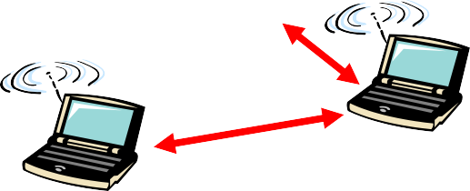
Hidden Node Problem
C
B
A
B
C
A
B and A can hear each other B and C can hear each other
A and C cannot hear each other
⇒ C is hidden for A and vice versa
C may start transmitting while A is also transmitting A and C can't detect collision.
Only the receiver can help avoid collisions

Slide 32




802.11 LAN architecture
Internet
wireless host communicates with base station
base station = access point (AP)
Basic Service Set (BSS) (aka “cell”) in infrastructure mode contains:
wireless hosts
access point (AP): base station
ad hoc mode: hosts only
switch
or router
BSS 1
BSS 2

Slide 33
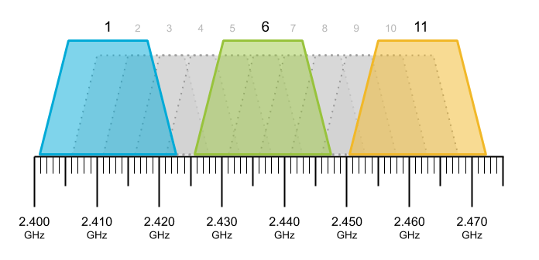
802.11: Channels
spectrum divided into channels at different frequencies
AP admin chooses frequency for AP
interference possible: channel can be same as that chosen by neighboring AP!
Example: 2.4 GHz
Notes:
recall that 802.11 operates in the frequency range of 2.4 GHz to 2.4835 GHz. Within this 85 MHz band, 802.11 defines 11 partially overlapping channels.

Slide 34
802.11: Association
arriving host: must associate with an AP
scans channels, listening for beacon frames containing AP’s name (SSID) and MAC address
selects AP to associate with
then may perform authentication [Chapter 8]
then typically run DHCP to get IP address in AP’s subnet
BSS

Slide 35
802.11: passive/active scanning
BBS 1
BBS 2
BBS 1
BBS 2
1
1
AP 2
AP 1
1
AP 2
2
2
2
AP 1
3
3
4
H1
H1
passive scanning:
beacon frames sent from APs
association Request frame sent: H1 to selected AP
association Response frame sent from selected AP to H1
active scanning:
Probe Request frame broadcast from H1
Probe Response frames sent from APs
Association Request frame sent: H1 to selected AP
Association Response frame sent from selected AP to H1

Slide 36




IEEE 802.11: multiple access
avoid collisions: 2⁺ nodes transmitting at same time
802.11: CSMA - sense before transmitting
don’t collide with detected ongoing transmission by another node
802.11: no collision detection!
difficult to sense collisions: high transmitting signal, weak received signal due to fading
can’t sense all collisions in any case: hidden terminal, fading
goal: avoid collisions: CSMA/CollisionAvoidance
A
B
C
C
B
A’s signal
strength
C’s signal
strength
A
space

Slide 37
4-Way Handshake
Carrier Sense Multiple Access with Collision Avoidance (CSMA/CA)
Listen before you talk. If the medium is busy, the transmitter backs off for a random period.
Avoids collision by sending a short message: Ready to send (RTS)
RTS contains dest. address and duration of message. Tells everyone to backoff for the duration.
Destination sends: Clear to send (CTS)
Can not detect collision ⇒ Each packet is acked.
MAC level retransmission if not acked.
Access Point
Mobile Node
Ready to send (RTS)
Clear to send (CTS)
Data
Ack

Slide 38
IEEE 802.11 Architecture
Server
Access Point
Access Point
Ad-hoc Station
Station
Ad-hoc Station
Station Station
Station
Basic Service Set
2nd BSS
Ad-hoc network

Slide 39
IEEE 802.11 Architecture Cont
Basic Service Area (BSA) = Cell
Area: Geographical area = a room, or a building
Each BSA may have several wireless LANs
Extended Service Area (ESA) = Multiple BSAs interconnected via Access Points (AP) = Multiple rooms in your home with different extenders advertising the same SSID
Basic Service Set (BSS)
= Set of stations associated with an AP ={MAC₁,…,MAC_{n}}. Each BSS has a Service Set ID (SSID), e. g., WUSTL-Guest
Extended Service Set (ESS)
= Set of stations in an ESA
Ad-hoc networks coexist and interoperate with infrastructure- based networks.

Slide 40
IEEE 802.11 MAC Protocol: CSMA/CA
802.11 sender
1 if sense channel idle for DIFS (Distributed Interframe Space) then
transmit entire frame (no CD)
sender
receiver
DIFS
2 if sense channel busy then
start random backoff time
timer counts down while channel idle
transmit when timer expires
if no ACK, increase random backoff interval, repeat 2
data
SIFS
802.11 receiver
if frame received OK
return ACK after SIFS (Short Interframe Space) (ACK needed due to hidden terminal problem)
SIFS is a shorter interframe space used between frames of an ongoing communication session where no contention is required.
ACK

Slide 41
Avoiding collisions (more)
idea: sender “reserves” channel use for data frames using small reservation packets
sender first transmits small request-to-send (RTS) packet to BS using CSMA
RTSs may still collide with each other (but they’re short)
BS broadcasts clear-to-send CTS in response to RTS
CTS heard by all nodes
sender transmits data frame
other stations defer transmissions

Slide 42

Collision Avoidance: RTS-CTS exchange
A
B
AP
RTS(A)
RTS(B)
reservation collision
RTS(A)
CTS(A)
CTS(A)
time
DATA (A)
defer
ACK(A)
ACK(A)

Slide 43
802.11: mobility within same subnet
H1 remains in same IP subnet: IP address can remain same
switch: which AP is associated with H1?
self-learning (Ch. 6): switch will see frame from H1 and “remember” which switch port can be used to reach H1
BBS 1
H1
BBS 2

Slide 44
802.11: advanced capabilities
10⁻¹
Rate adaptation
base station, mobile dynamically change transmission rate (physical layer modulation technique) as mobile moves, SNR (Signal-to-Noise Ratio) varies
10⁻²
10⁻³
BER
10⁻⁴
10⁻⁵
10⁻⁶
10⁻⁷
10
20
30
40
SNR(dB)
QAM256 (8 Mbps)
QAM16 (4 Mbps)
BPSK (1 Mbps)
operating point
1. SNR decreases, BER (Bit Error Rate) increases as node moves away from base station
QAM=Quadrature Amplitude Modulation
QAM2^{n} = n bits/Hz dB = Deci-Bel
Power Out
2. When BER becomes too high, switch to lower transmission rate but with lower BER
= 10 log
10 Power In

Slide 45
802.11: advanced capabilities
power management
A node can be in one of three states:
Transmitter on
Receiver only on
Dozing: Both transmitter and receivers off.
AP buffers traffic for dozing nodes.
node-to-AP: “I am going to sleep until next beacon frame”
AP knows not to transmit frames to this node
node wakes up before next beacon frame
beacon frame: contains list of mobile nodes with AP-to-mobile frames waiting to be sent
node will stay awake if AP-to-mobile frames to be sent; otherwise sleep again until next beacon frame

Slide 46
Chapter 7 outline
Introduction
Wireless
Wireless links and network characteristics
CDMA: code division multiple access
WiFi: 802.11 wireless LANs
Bluetooth

Slide 47
Personal area networks: Bluetooth
less than 10 m diameter
replacement for cables (mouse, keyboard, headphones)
ad hoc: no infrastructure
2.4-2.5 GHz ISM radio band, up to 3 Mbps
master controller / client devices:
master polls clients, grants requests for client transmissions
C
P
P
radius of
coverage
M
C
C
P
P
M
master controller
client device
parked device (inactive)
C
P

Slide 48
Personal area networks: Bluetooth
Started with Ericsson's Bluetooth Project in 1994
Named after Danish king Herald Blatand (AD 940-981) who was fond of blueberries
Radio-frequency communication between cell phones over short distances
IEEE 802.15.1 approved in early 2002 is based on Bluetooth
Key Features:
Lower Power: 10 A in standby, 50 mA while transmitting
Cheap: $5 per device
A piconet consists of a master and several slaves. Master determines the timing and polls slaves for transmission.
Frequency hopping spread spectrum
Frequency
Time

Slide 49
Personal area networks: Bluetooth
TDM, 625 μsec sec. slot
FDM: sender uses 79 frequency channels in known, pseudo-random order slot-to-slot (spread spectrum)
other devices/equipment not in piconet only interfere in some slots
parked mode: clients can “go to sleep” (park) and later wakeup (to preserve battery)
bootstrapping: nodes self-assemble (plug and play) into piconet
C
P
P
radius of
coverage
M
C
C
P
P
M
master controller
client device
parked device (inactive)
C
P

Slide 50
Summary
IEEE 802.11 PHYs: 11, 11b, 11g, 11a, 11n, …
IEEE 802.11 MAC uses CSMA/CA with a 4-way handshake: RTS, CTS, data, and ack
IEEE 802.11 network consists of ESS consisting of multiple BSSs each with an AP.
802.11 Frame Format may have up to 4 addresses and includes final destination’s MAC which may not be wireless
Power management allows stations to sleep.
Bluetooth uses frequency hopping spread spectrum
Notes:
IEEE 802.15.4 PHY layer allows coordinators to schedule transmissions of other nodes
ZigBee uses IEEE 802.15.4

Slide 51
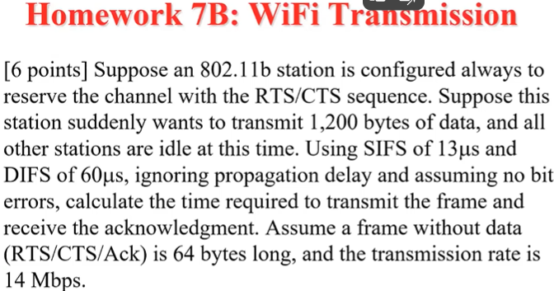
Homework 7B: WiFi Transmission
[6 points] Suppose an 802.11b station is configured always to reserve the channel with the RTS/CTS sequence. Suppose this station suddenly wants to transmit 1,200 bytes of data, and all other stations are idle at this time. Using SIFS of 13us and DIFS of 60µs, ignoring propagation delay and assuming no bit errors, calculate the time required to transmit the frame and receive the acknowledgment. Assume a frame without data (RTS/CTS/Ack) is 64 bytes long, and the transmission rate is 14 Mbps.

